Slide 1
Chapter 2 Application Layer
Email
Notes:
Version History
8.1. Updates throughout, including a lot more animations. These are the ppt files used to make Chapter 2 online lectures in Sept. 2020.
8.0 (April 2020)
All slides reformatted for 16:9 aspect ratio
All slides updated to 8th edition material
Use of Calibri font, rather that Gill Sans MT
Add LOTS more animation throughout

Slide 2
Email
One of the most popular Internet services is electronic mail (e-mail).
The designers of the Internet probably never imagined the popularity of this application program.
Its architecture consists of several components that we discuss in this chapter.

Slide 3
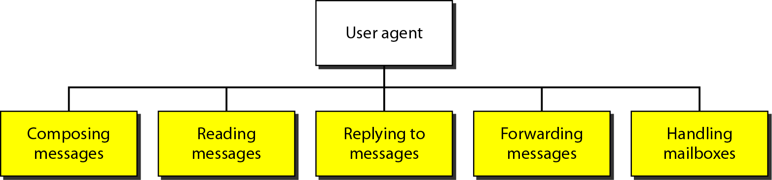
User Agent
It provides service to the user to make the process of sending and receiving a message easier.
e.g., Outlook, Thunderbird, iPhone mail client

Slide 4

Electronic mail
outgoing
message queue
user mailbox
Three major components:
user agents
mail servers
simple mail transfer protocol: SMTP
User Agent
a.k.a. “mail reader”
composing, editing, reading mail messages
e.g., Outlook, Thunderbird, iPhone mail client
outgoing, incoming messages stored on server
user
agent
mail
server
user
agent
SMTP
mail
server
user
agent
SMTP
SMTP
user
agent
mail
server
user
agent
user
agent

Slide 5
Electronic mail: mail servers
mail servers:
mailbox contains incoming messages for user
message queue of outgoing (to be sent) mail messages
SMTP protocol between mail servers to send email messages
client: sending mail server
“server”: receiving mail server
user
agent
mail
server
user
agent
SMTP
mail
server
user
agent
SMTP
SMTP
user
agent
mail
server
user
agent
user
agent

Slide 6
Email - Architecture
To explain the architecture of e-mail, we give four scenarios. We begin with the simplest situation and add complexity as we proceed. The fourth scenario is the most common in the exchange of e-mail.

Slide 7
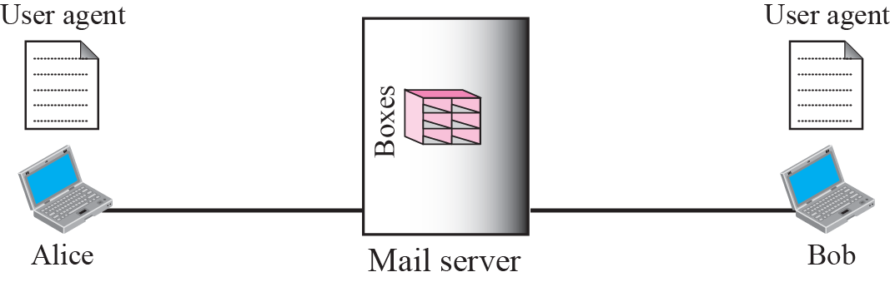

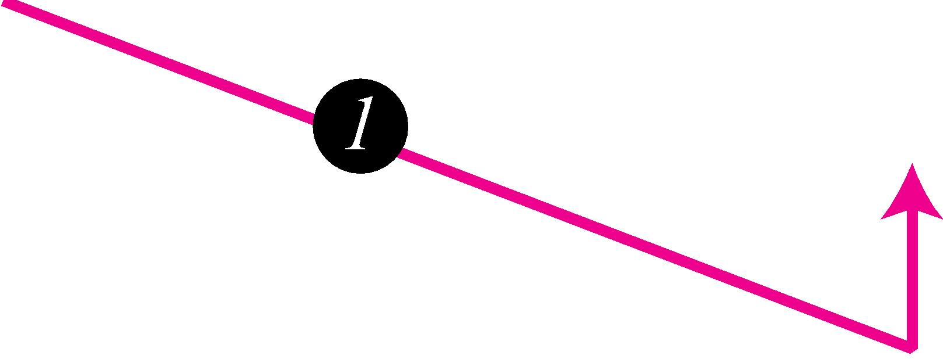
Email - Architecture
First scenario
When the sender and the receiver of an e-mail are on the same mail server (both using gmail),
we need only two user agents.

Slide 8
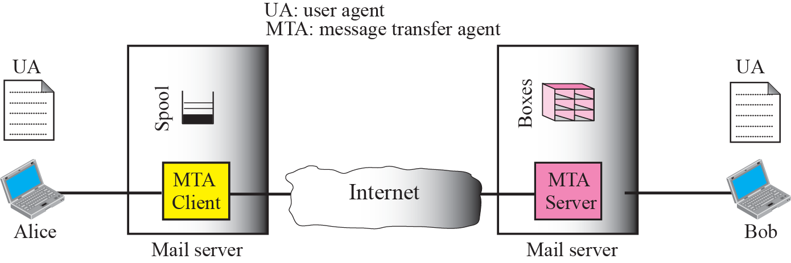
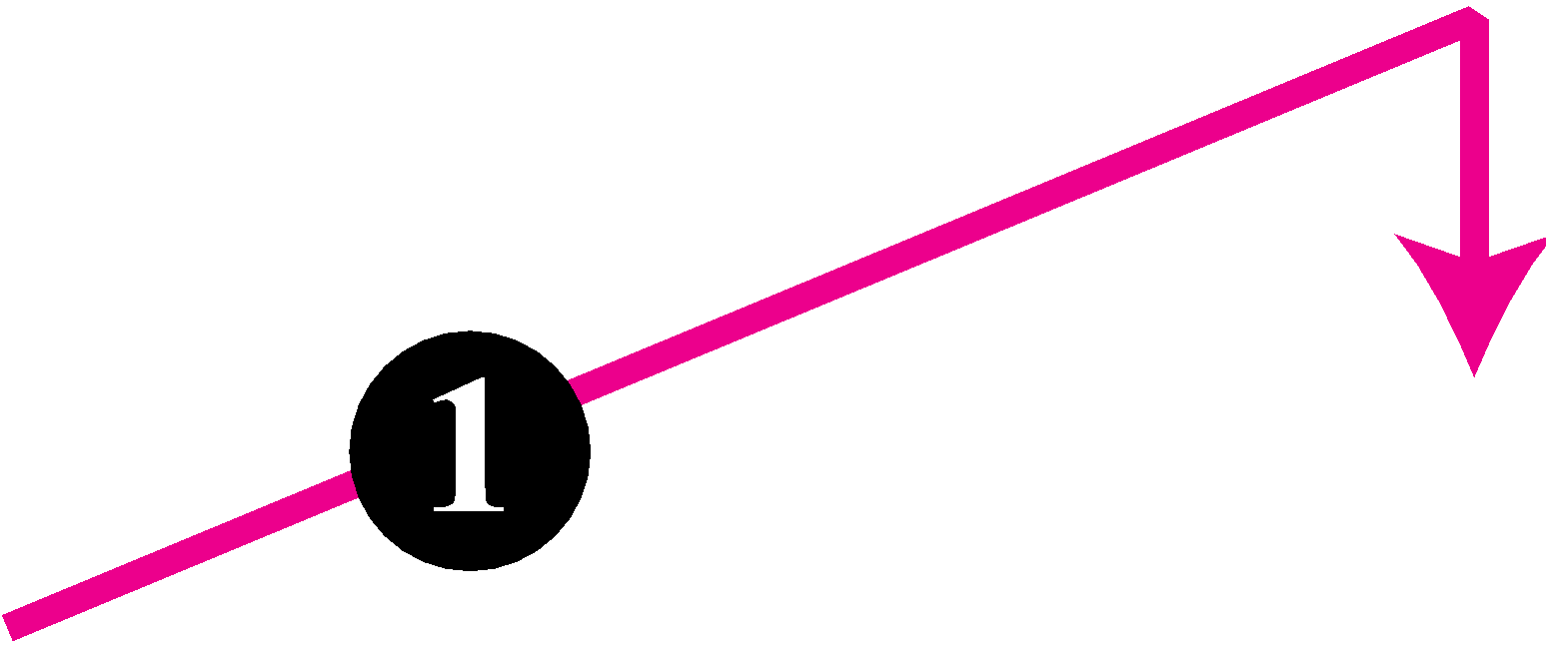
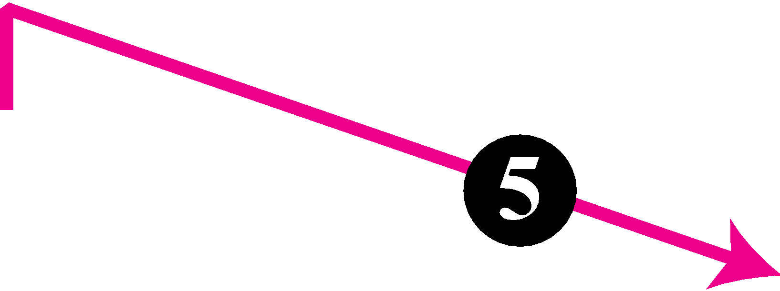
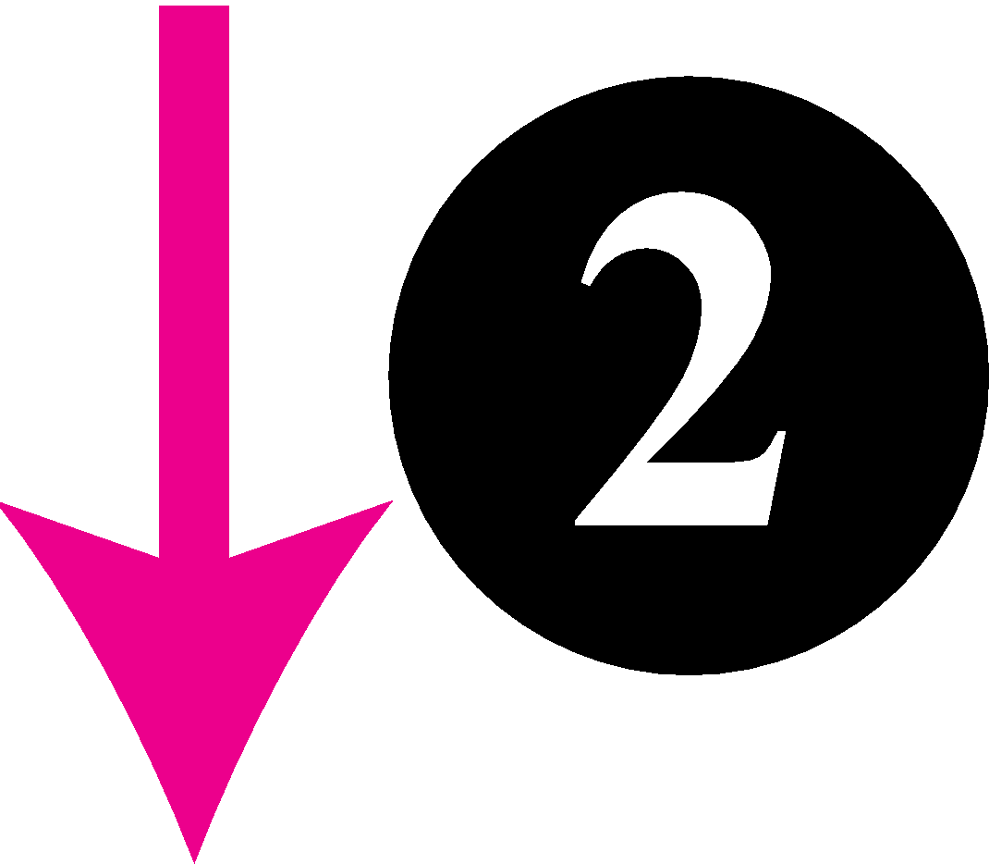


Email - Architecture
2nd scenario
When the sender and the receiver of an e-mail are on different mail servers,
we need two UAs and a pair of MTAs (client and server).

Slide 9
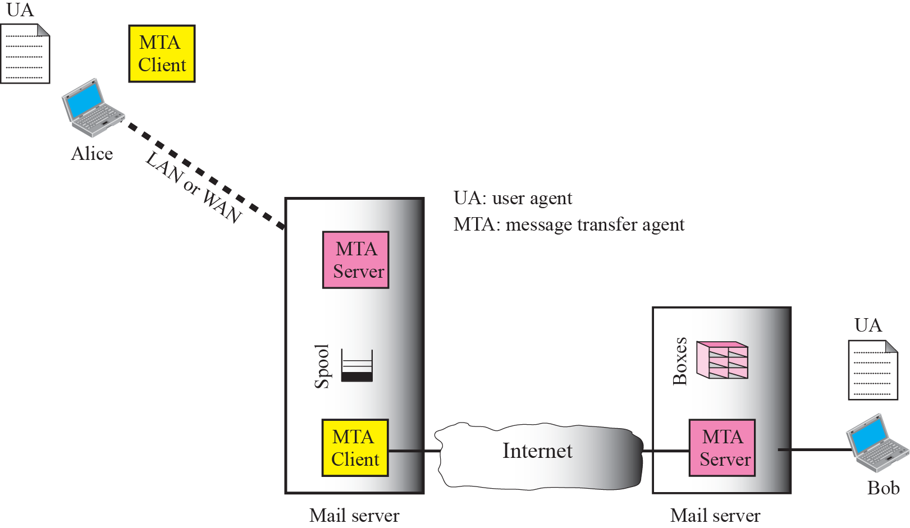

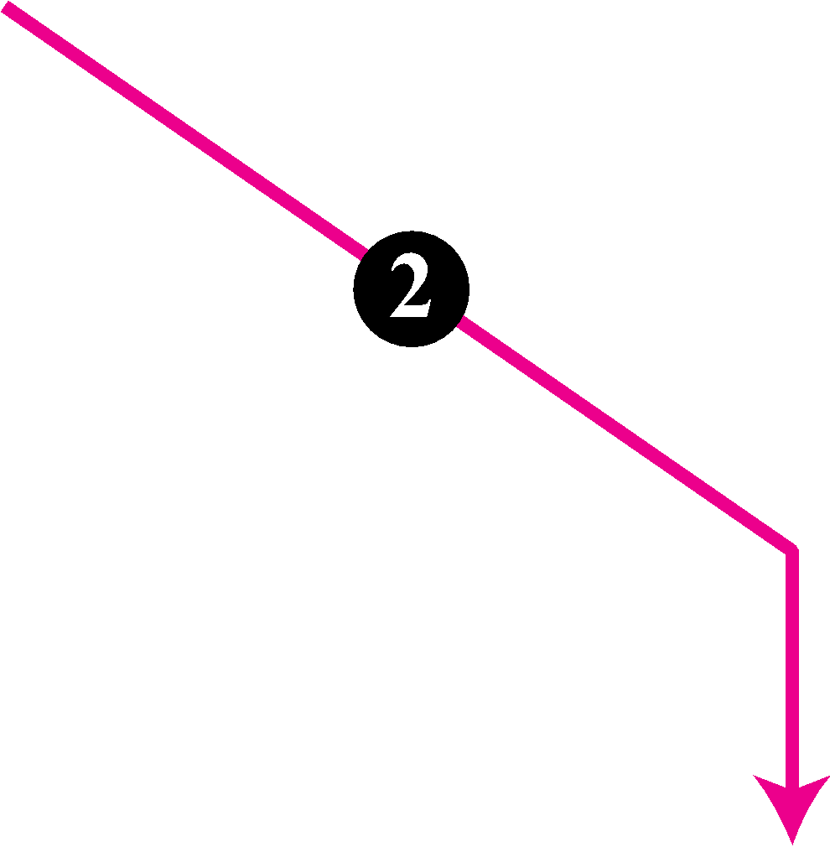
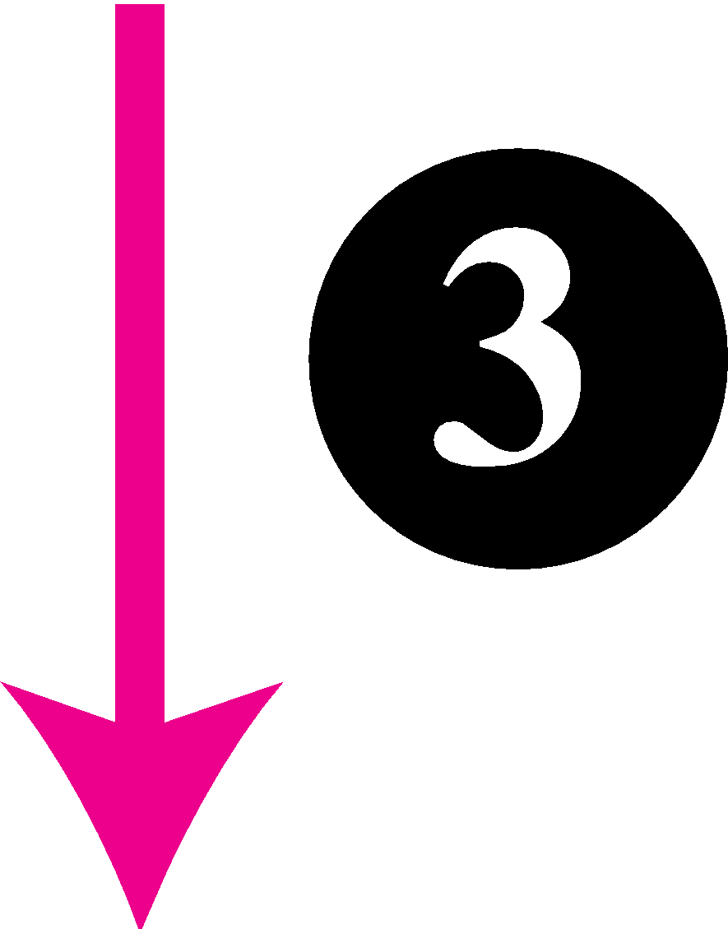
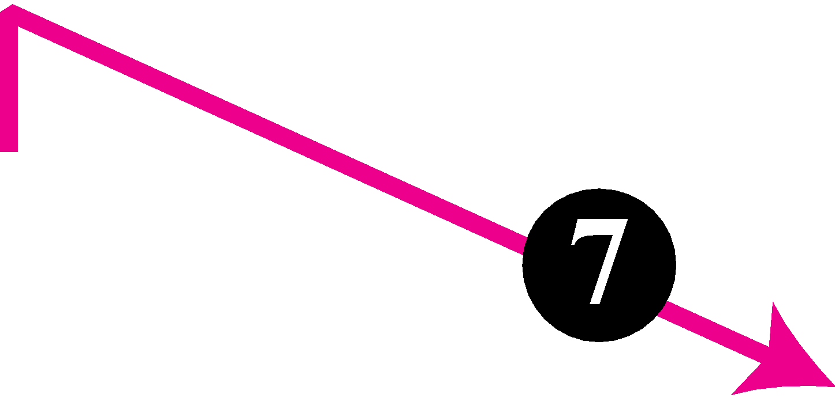



Email - Architecture
3rd scenario
When the sender is connected to the mail server via a LAN /WAN
we need two UAs and two pairs of MTAs (client and server).

Slide 10
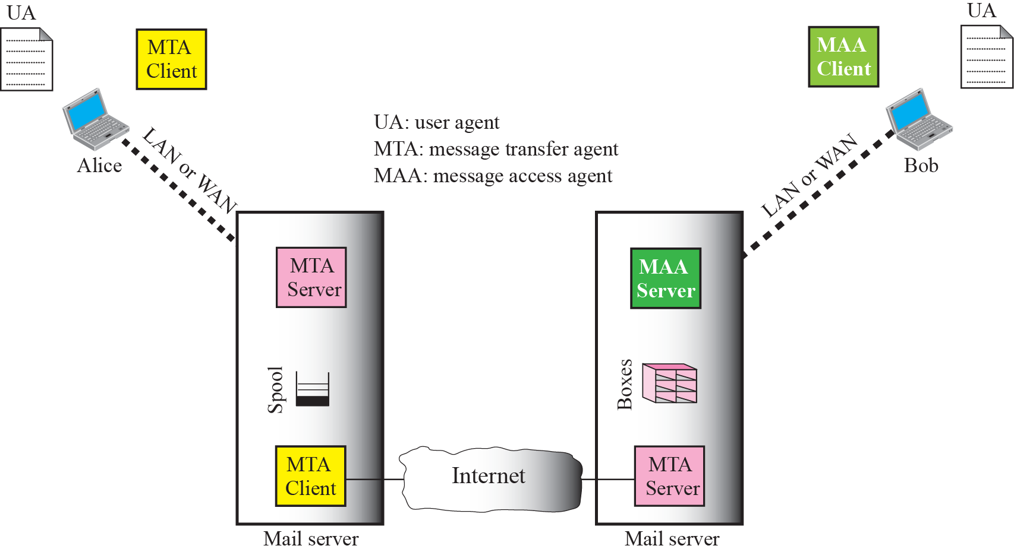

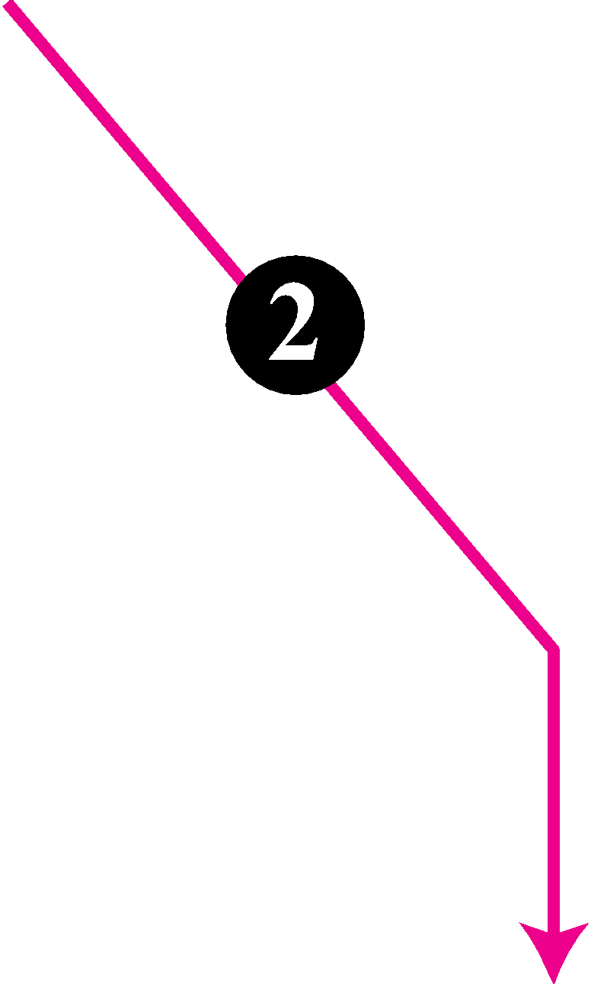

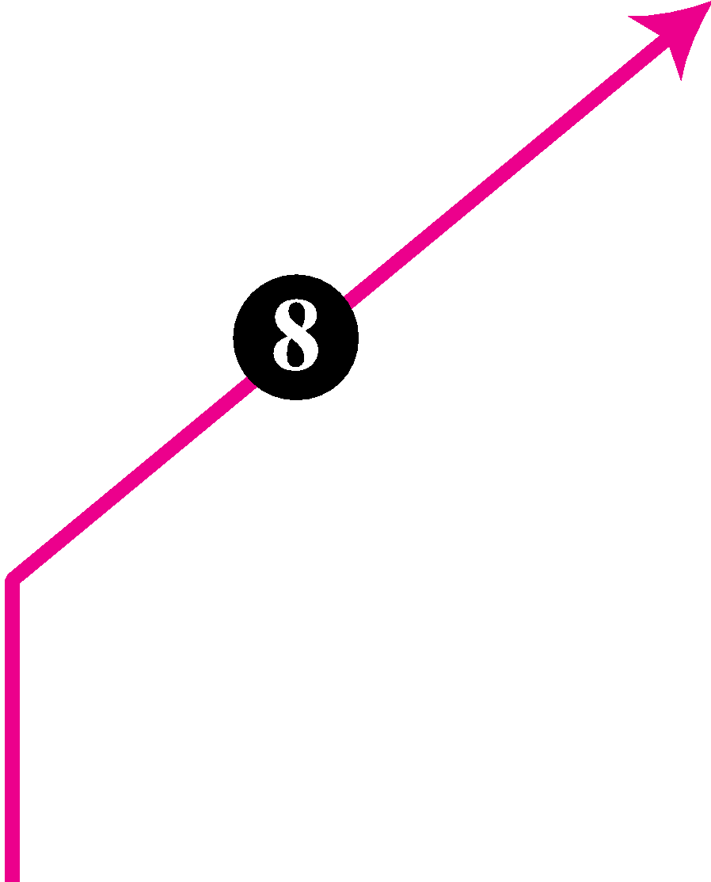


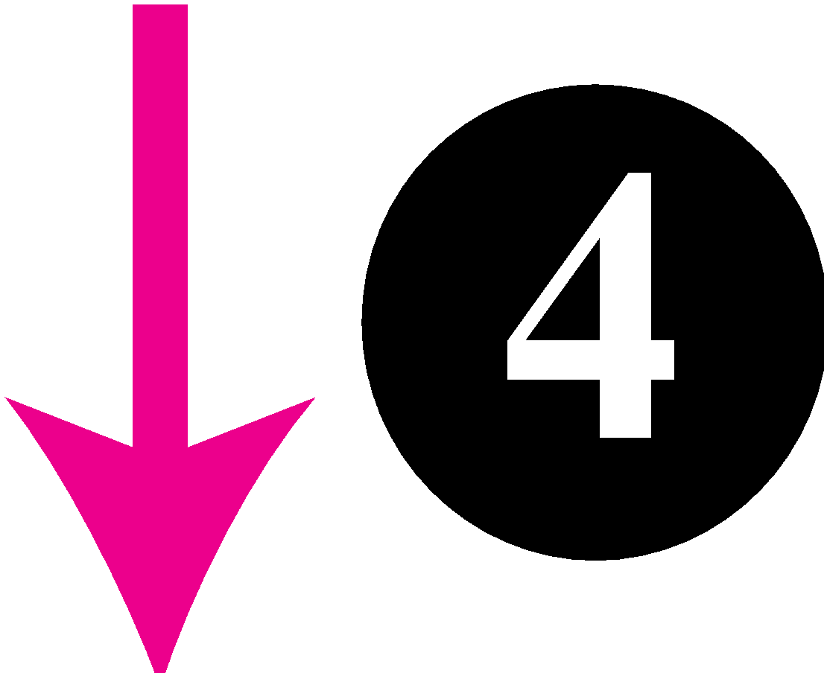


Email – Architecture
4th scenario
both sender and receiver are connected to the mail server via a LAN/ WAN
need two UAs, two pairs of MTAs (client and server), and a pair of MAAs (client and server).
This is the most common situation today.

Slide 11
Message Transfer Agent
The actual mail transfer is done through message transfer agents (MTAs).
To send mail, a system must have the client MTA, and to receive mail, a system must have a server MTA.
The formal protocol that defines the MTA client and server in the Internet is called Simple Mail Transfer Protocol (SMTP).

Slide 12
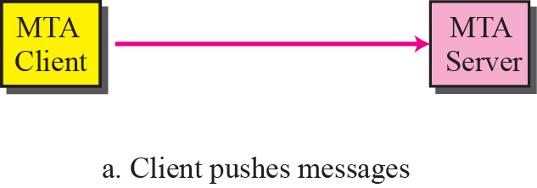
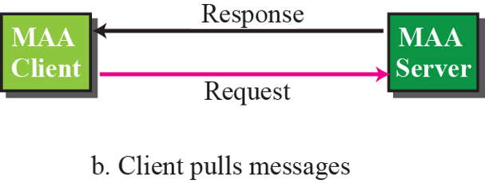
Figure 23.5 Push versus pull

Slide 13
Electronic Mail: SMTP [RFC 2821]
uses TCP to reliably transfer email message from client to server, port 25
direct transfer: sending server to receiving server
three phases of transfer
handshaking (greeting)
transfer of messages
closure
command/response interaction (like HTTP, FTP)
commands: ASCII text
response: status code and phrase
messages must be in 7-bit ASCI

Slide 14
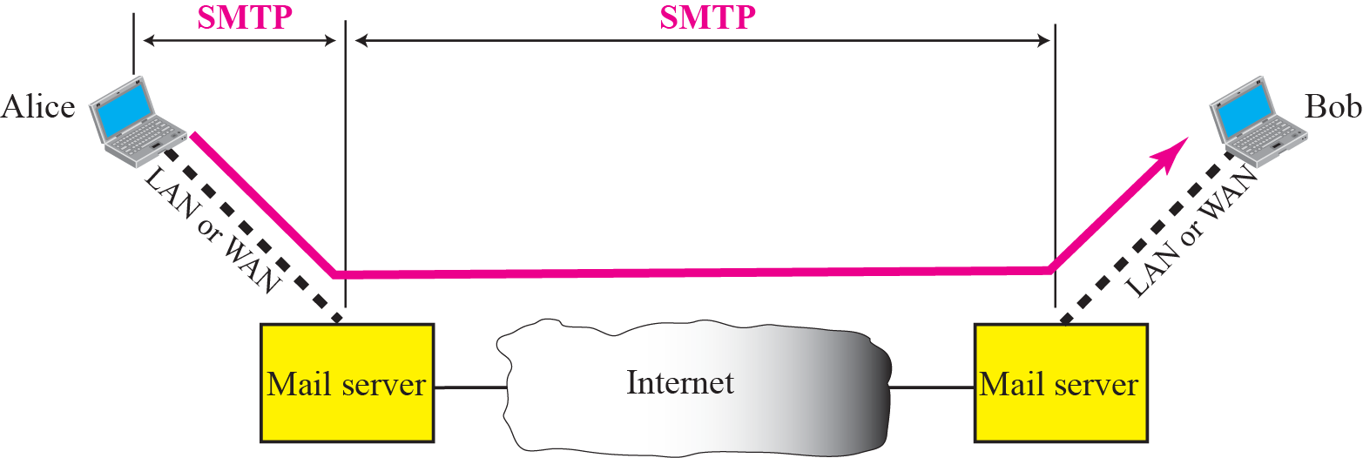
Electronic Mail: SMTP [RFC 2821]
Range of SMTP

Slide 15

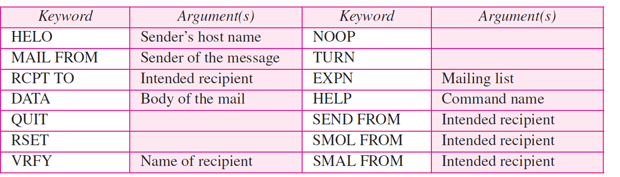
Electronic Mail: SMTP [RFC 2821]
Commands

Slide 16
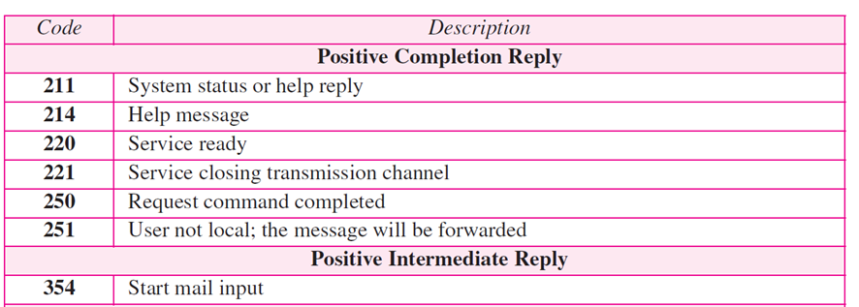
Electronic Mail: SMTP [RFC 2821]
Responses

Slide 17
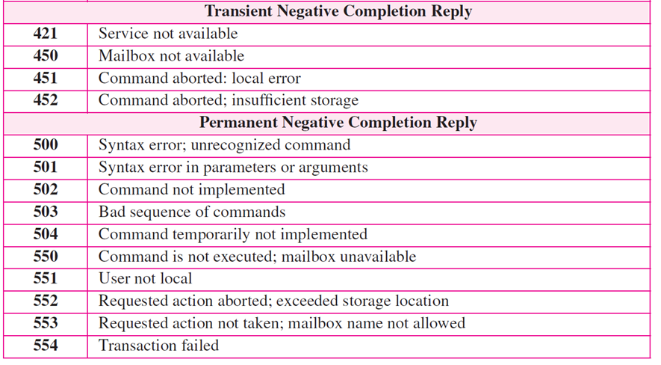
Electronic Mail: SMTP [RFC 2821]

Slide 18


Scenario: Alice sends message to Bob
1) Alice uses UA to compose message “to” bob@someschool.edu
2) Alice’s UA sends message to her mail server; message placed in message queue
3) client side of SMTP opens TCP connection with Bob’s mail server
4) SMTP client sends Alice’s message over the TCP connection
5) Bob’s mail server places the message in Bob’s mailbox
6) Bob invokes his user agent to read message
user
agent
mail
server
user
agent
1
mail
server
2
3
6
4
Alice’s mail server
5
Bob’s mail server

Slide 19
Sample SMTP interaction
S: 220 hamburger.edu
C: HELO crepes.fr
S: 250 Hello crepes.fr, pleased to meet you
C: MAIL FROM: <alice@crepes.fr>
S: 250 alice@crepes.fr... Sender ok
C: RCPT TO: <bob@hamburger.edu>
S: 250 bob@hamburger.edu ... Recipient ok
C: DATA
S: 354 Enter mail, end with "." on a line by itself
C: Do you like ketchup?
C: How about pickles?
C: .
S: 250 Message accepted for delivery
C: QUIT
S: 221 hamburger.edu closing connection

Slide 20
Sample SMTP interaction
Connection Establishment or handshaking
SMTP
Client
SMTP
Server

Slide 21
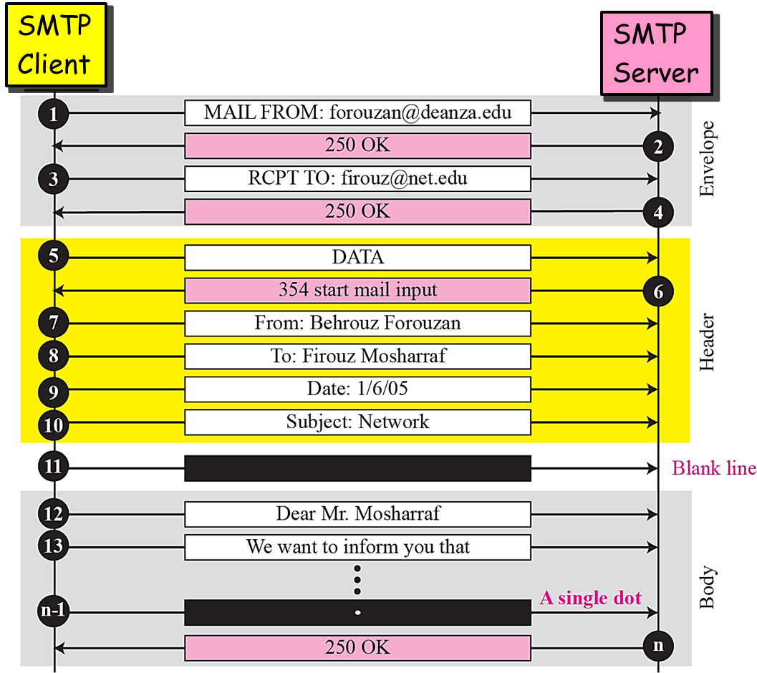
Sample SMTP interaction- Message Transfer

Slide 22
Sample SMTP interaction
Connection termination
SMTP
Client
SMTP
Server

Slide 23
Mail message format
SMTP: protocol for exchanging email msgs
RFC 822: standard for text message format:
header lines, e.g.,
To:
From:
Subject:
different from SMTP MAIL FROM, RCPT TO: commands!
Body: the “message”
ASCII characters only
header
blank
line
body

Slide 24
SMTP: final words
SMTP uses persistent connections
SMTP requires message (header & body) to be in 7-bit ASCII
SMTP server uses CRLF.CRLF to determine end of message
comparison with HTTP:
HTTP: pull
SMTP: push
both have ASCII command/response interaction, status codes
HTTP: each object encapsulated in its own response msg
SMTP: multiple objects sent in multipart msg

Slide 25
Mail Access Agents
user
agent
mail access
protocol
user
agent
SMTP
SMTP
(e.g., POP,
IMAP)
sender’s mail
server
receiver’s mail
server
SMTP: is a push protocol; it pushes the message from the client to the server.
On the other hand, the third stage needs a pull protocol;
the client must pull messages from the server.
The third stage uses a message access agent.

Slide 26
Mail Access Protocols
user
agent
mail access
protocol
user
agent
SMTP
SMTP
(e.g., POP,
IMAP)
sender’s mail
server
receiver’s mail
server
POP: Post Office Protocol [RFC 1939]:
port TCP/110
authorization, download
IMAP: Internet Mail Access Protocol [RFC 1730]:
more features, (more complex)
including manipulation of stored msgs on server
port 150
HTTP: gmail, Hotmail, Yahoo! Mail, etc.

Slide 27
POP3
POP3 protocol supports the ability to download a specific message or set of messages and leave them on the server.
Most e-mail programs just download everything and empty the mailbox.
This behavior means that in practice, the only copy is on the user's hard disk. If that crashes, all e-mail may be lost permanently.

Slide 28
POP3 protocol
S: +OK POP3 server ready
C: user bob
S: +OK
C: pass hungry
S: +OK user successfully logged on
authorization phase
client commands:
user: declare username
pass: password
server responses
+OK
-ERR
transaction phase, client:
list: list message numbers
retr: retrieve message by number
dele: delete
quit
C: list
S: 1 498
S: 2 912
S: .
C: retr 1
S: <message 1 contents>
S: .
C: dele 1
C: retr 2
S: <message 1 contents>
S: .
C: dele 2
C: quit
S: +OK POP3 server signing off

Slide 29
Limitations of POP
Does not handle multiple mailboxes easily
Designed to put user’s incoming e-mail in one folder
Not designed to keep messages on the server
Instead, designed to download messages to the client
Poor handling of multiple-client access to mailbox
Increasingly important as users have home PC, work PC, laptop, cyber café computer, friend’s machine, etc.
High network bandwidth overhead
Transfers all of the e-mail messages, often well before they are read (and they might not be read at all!)

Slide 30
IMAP – Internet Message Access Protocol
What happens if a user opens his mailbox in more than one place?
Many people have a single e-mail account at work or school and want to access it from work, from their home PC, from their laptop when on business trips, etc.
While POP3 allows this, since it normally downloads all stored messages at each contact, the result is that the user's e-mail quickly gets spread over multiple machines, more or less at random, some of them not even the user's.

Slide 31
IMAP Policy
IMAP assumes that all the e-mail will remain on the server indefinitely in multiple mailboxes.
IMAP provides extensive mechanisms for reading messages or even parts of messages, a feature useful when using a slow modem to read the text part of a multipart message with large audio and video attachments.
Since the working assumption is that messages will not be transferred to the user's computer for permanent storage, IMAP provides mechanisms for creating, destroying, and manipulating multiple mailboxes on the server.
In this way a user can maintain a mailbox for each correspondent and move messages there from the inbox after they have been read.

Slide 32
Internet Message Access Protocol (IMAP)
Developed after POP and attempts to fix POP deficiencies
allows keeping all mail on the server
allows mail categorization via folder metaphor
mail is easily flagged (answered, draft, deleted, seen, recent); this isn’t the same on all servers
provides for multiple connections to the server

Slide 33
IMAP - process
make connection
send user credentials (userid and password)
repeat until done
send a command
read response
disconnect

Slide 34
IMAP - Commands
login
list
status
examine
select
create, delete, rename
fetch
store
close
expunge
copy
idle
lsub, subscribe, unsubscribe
logout
capability, getquotaroot, getacl

Slide 35
POP3 (more) and IMAP
more about POP3
previous example uses POP3 “download and delete” mode
Bob cannot re-read e-mail if he changes client
POP3 “download-and-keep”: copies of messages on different clients
POP3 is stateless across sessions
IMAP
keeps all messages in one place: at server
allows user to organize messages in folders
keeps user state across sessions:
names of folders and mappings between message IDs and folder name

Slide 36
A comparison of POP3 and IMAP
Feature | POP3 | IMAP
Where is emails stored?
Where is emails read?
Connect time required
Use of server resources
Multiple mailboxes
User control over downloading
Partial message downloads
Are disk quotas a problem?
Simple to implement
Keeps user state
User’s PC
Server
Off-line
On-line
Little
Much
Minimal
Extensive
No
Yes
Little
Great
No
Yes
No
Could be
Yes
No
No
Yes

Slide 37
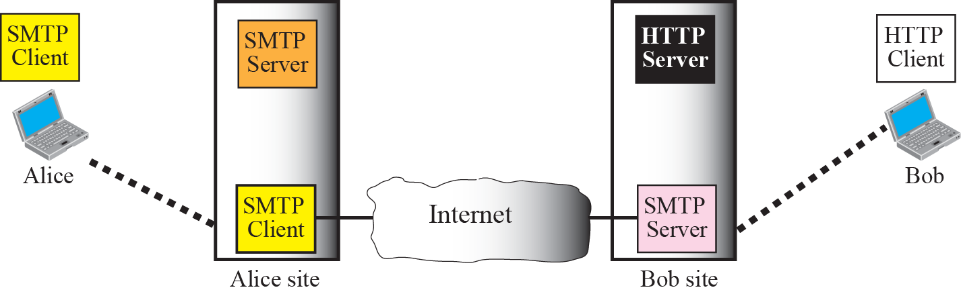

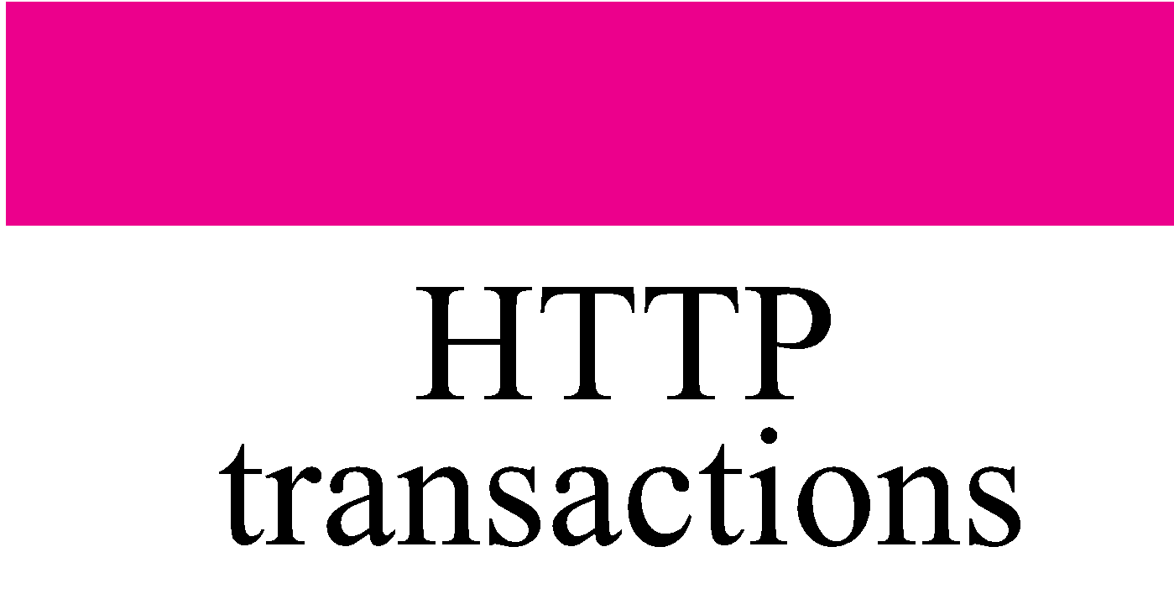



Web-Based E-Mail
case 1

Slide 38

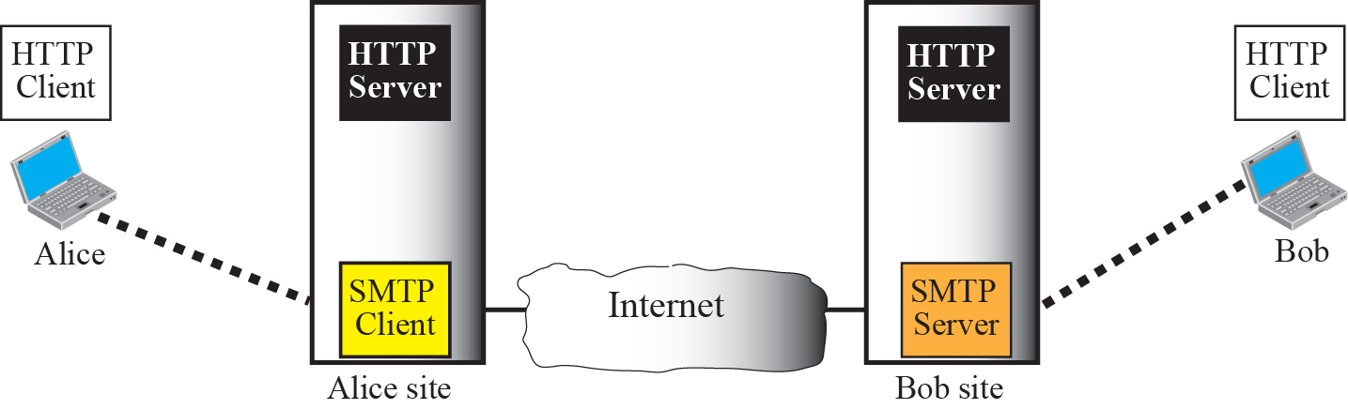



Web-Based E-Mail
case 2

Slide 39
Web-Based E-Mail
User agent is an ordinary Web browser
User communicates with server via HTTP
E.g., Gmail, Yahoo mail, and Hotmail
Reading e-mail
Web pages display the contents of folders
… and allow users to download and view messages
“GET” request to retrieve the various Web pages
Sending e-mail
User types the text into a form and submits to the server
“POST” request to upload data to the server
Server uses SMTP to deliver message to other servers
Easy to send anonymous e-mail (e.g., spam)

Slide 40
Web-Mail
Some Web sites, for example, Hotmail and Yahoo, provide e-mail service.
They have normal message transfer agents listening to port 25 for incoming SMTP connections.
To contact, say, Hotmail, you need to establish a TCP connection over which SMTP commands can be sent in the usual way.
When the user goes to the e-mail Web page, a form is presented in which the user is asked for a login name and password.
When the user clicks on Sign In, the login name and password are sent to the server, which then validates them.
The server finds the user's mailbox and builds a listing page, only formatted as a Web page in HTML. The Web page is then sent to the browser for display.

Slide 41
E-Mail Message - again
E-mail messages have two parts
A header, in 7-bit U.S. ASCII text
A body, also represented in 7-bit U.S. ASCII text
Header
Lines with “type: value”
“To: jrex@princeton.edu”
“Subject: Go Tigers!”
Body
The text message
No particular structure or meaning
header
blank
line
body

Slide 42
Limitation: Sending Non-Text Data
E-mail body is 7-bit U.S. ASCII
What about non-English text?
What about binary files (e.g., images and executables)?
Solution: MIME

Slide 43
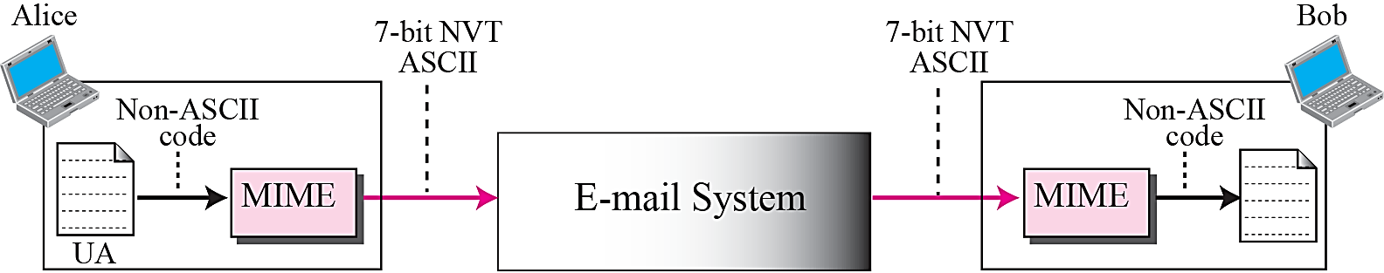
MIME – What is it?
Multipurpose Internet Mail Extensions
MIME permits the inclusion of virtually any type of file or document in an email message.
Specifically, MIME messages can contain
text, images, audio, video
application-specific data.
spreadsheets
word processing documets

Slide 44
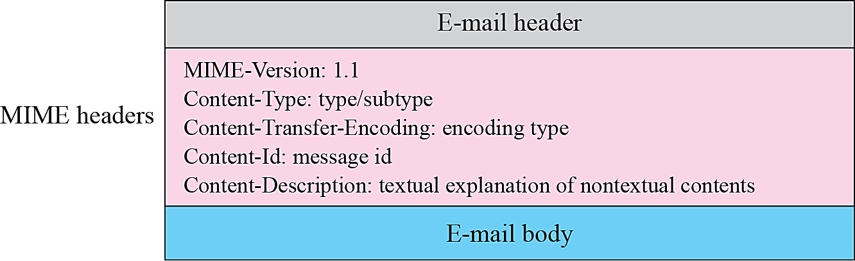
MIME
Additional headers to describe the message body

Slide 45
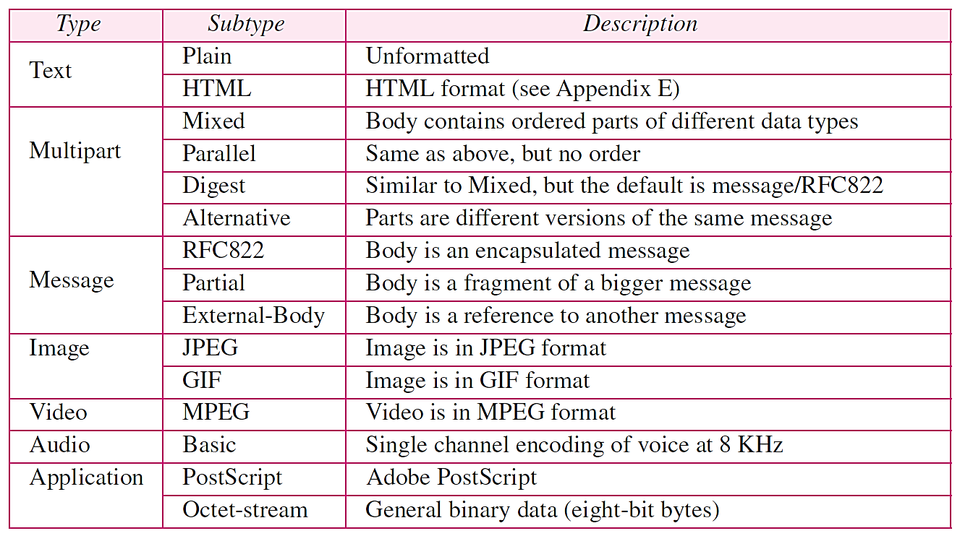
MIME – content type/sub type

Slide 46
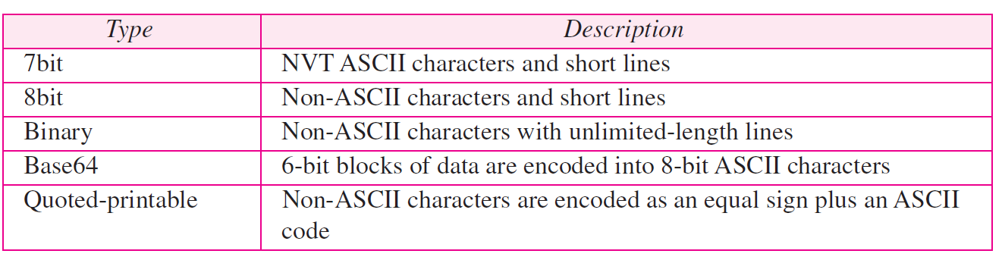
MIME – content transfer encoding

Slide 47
Example: E-Mail Message Using MIME
MIME version
From: jrex@cs.princeton.edu
To: feamster@cc.gatech.edu
Subject: picture of Thomas Sweet
MIME-Version: 1.0
Content-Transfer-Encoding: base64
Content-Type: image/jpeg
base64 encoded data .....
.........................
......base64 encoded data
method used
to encode data
type and subtype
encoded data

Slide 48
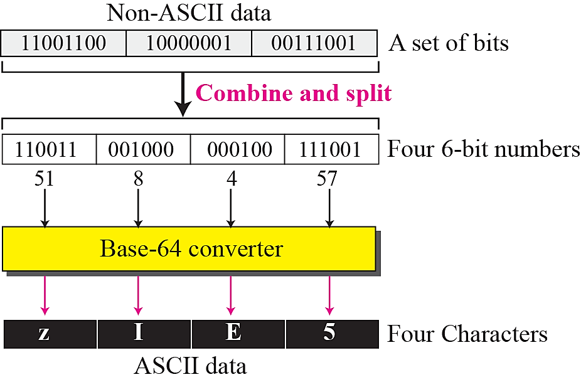
Base64 encoding
Base64 encoding: map each group of three bytes into four printable U.S.-ASCII characters

Slide 49
References
erdos.csie.ncnu.edu.tw/~ccyang/TCPIP/Slides/Chap-23.ppt
www.hit.ac.il/staff/commEng/Perelroyzen/3electronic_mail_protocols.ppt
www.cs.princeton.edu/courses/archive/spr06/cos461/slides/19Email.ppt
www.cs.binghamton.edu/~steflik/cs328/eMailProtocols.ppt
ece626web.groups.et.byu.net/Lectures/ch26.ppt

